Slide 1


PRESENTATION ON
EDA ON HOUSING PRICES DATASET
PRESENTED BY
N.RAJESHWAR RAO
M.VENKAT
SAINI KAVYA

Slide 2
INTRODUCTION
Exploratory Data Analysis (EDA) is used to understand the housing price data
It helps analyze property prices in relation to factors such as area, location, number of bedrooms, and other housing features.
Statistical summaries and visualizations help identify price distributions, variations across locations, and anomalies such as outliers or unusual listings..
EDA supports better decision-making by improving data quality, identifying missing or duplicate records, and providing insights into housing market trends in Hyderabad.

Slide 3
OBJECTIVE
Identify key patterns and trends.
Understand relationships between variables.
Detect anomalies or data quality issues.
Discover meaningful insights that highlight biases, imbalances, and underlying patterns
within the dataset.

Slide 4
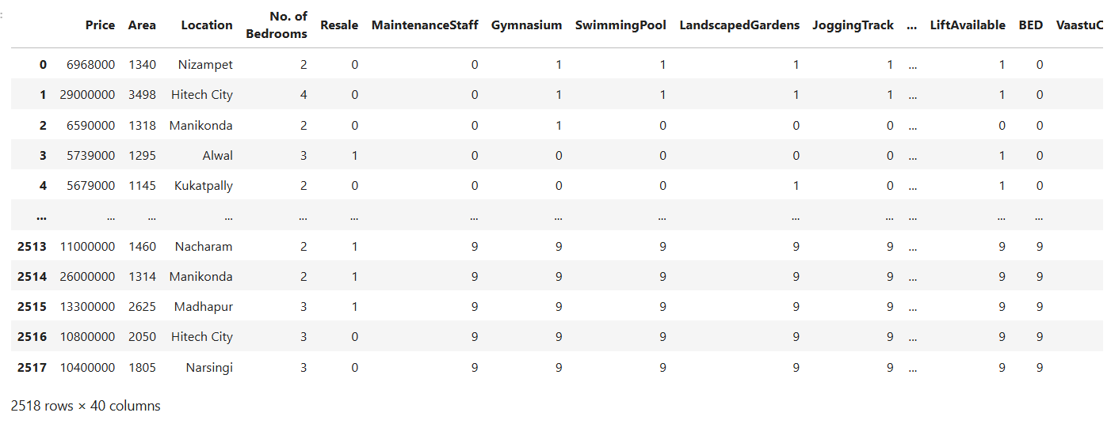
DATA SET

Slide 5
KEY COLUMNS OVERVIEW
Price – The total price of the house or property.
Area (sq.ft) – The built-up area of the house in square feet.
Location – The area or locality where the property is located in Hyderabad.
Bedrooms / BHK – Number of bedrooms in the house.
Bathrooms – Number of bathrooms available in the property.

Slide 6

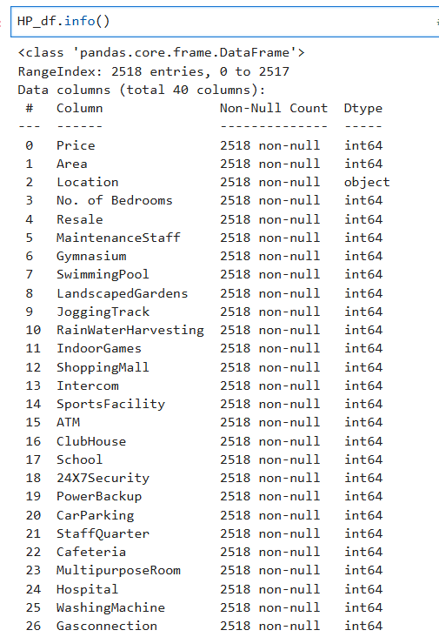
DATA UNDERSTANDING
df.shape gives the total number of rows and columns in the dataset, helping us understand its overall size.
df.info() provides the structure of the dataset, including data types and missing values, which is essential for further cleaning.

Slide 7
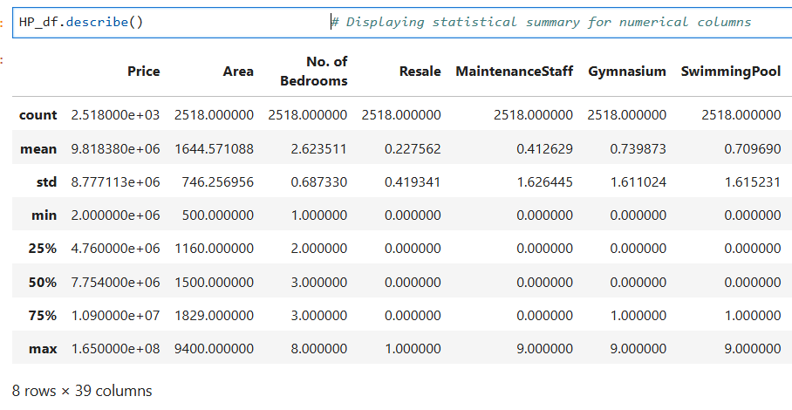
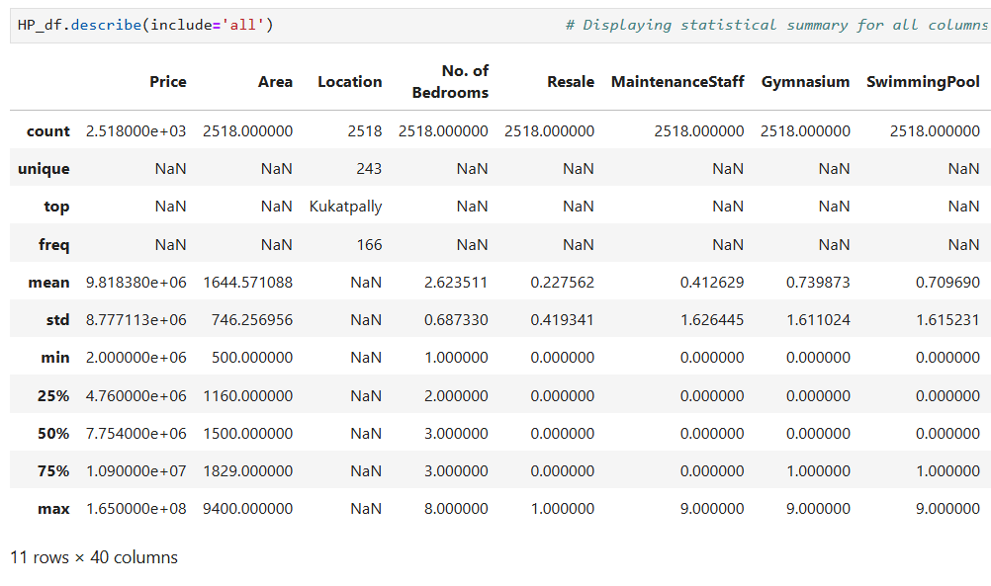
This function provides summary statistics for all numerical columns, such as mean, minimum, maximum, and standard deviation.
This command generates summary statistics for categorical columns, showing the number of unique values, the most frequent category, and its frequency.

Slide 8
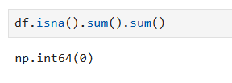

DATA CLEANING
The dataset contains no missing values across any of the columns, indicating high data completeness and quality. As a result, no null-value treatment is required before performing further analysis or modeling.
The dataset contains duplicate records, indicating a small level of data redundancy. These duplicates should be reviewed and removed if necessary to ensure accurate analysis and reliable results.

Slide 9
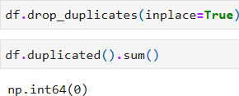
HANDLING DUPLICATE VALUES
The duplicate record has been successfully removed from the dataset. Now, there are no duplicate rows, and the data is clean for further analysis.

Slide 10
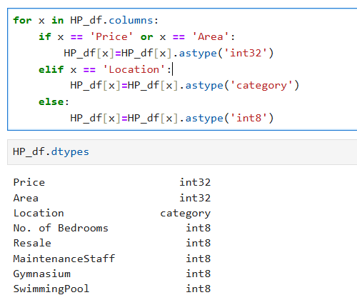
DATA TYPE CORRECTION
The location is changed from object to category format.Also the memory optimization is done for all variables in the dataset.

Slide 11
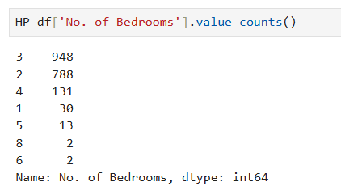
UNIVARIATE ANALYSIS (non-visualization)
The dataset is dominated by 2 and 3 bedroom houses, with 3-bedroom properties being the most common.
Houses with higher bedroom counts (4 and above) are relatively few, indicating limited availability of large or luxury properties

Slide 12
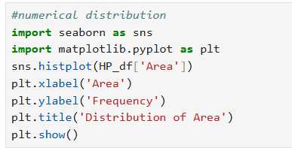
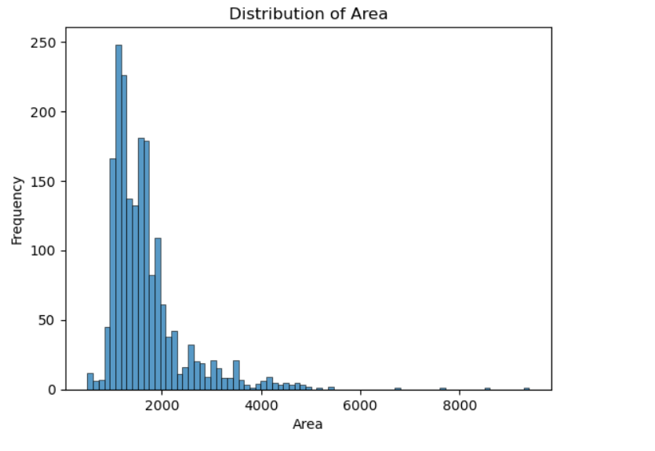
UNIVARIATE ANALYSIS
(visualization)
• The distribution of house prices shows right skewness, indicating more mid-range houses and fewer high-priced properties.

Slide 13
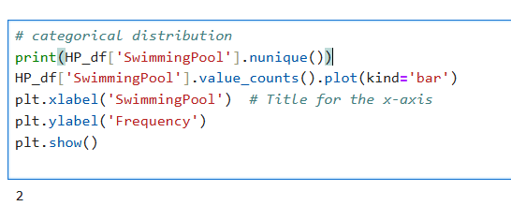
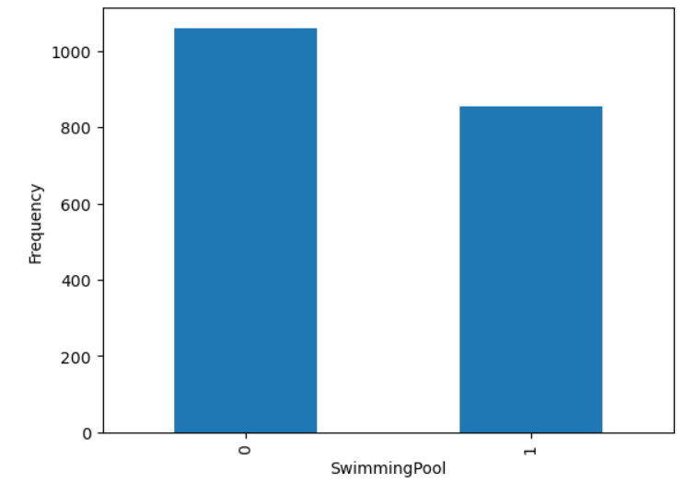
Area values are mostly concentrated within a common range, with a few very large properties acting as outliers.

Slide 14
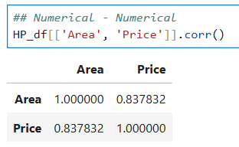
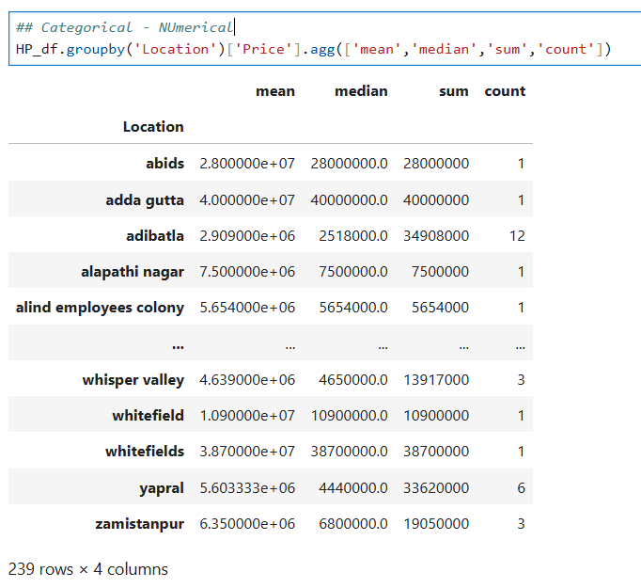
BIVARIATE ANALYSIS (non-visualization)
Area (sq ft) and Price show a strong positive correlation, indicating that properties with larger areas tend to have higher prices with minimal variation.
The analysis shows that average and median house prices vary significantly across different locations, indicating that location plays a major role in determining property prices in Hyderabad.

Slide 15
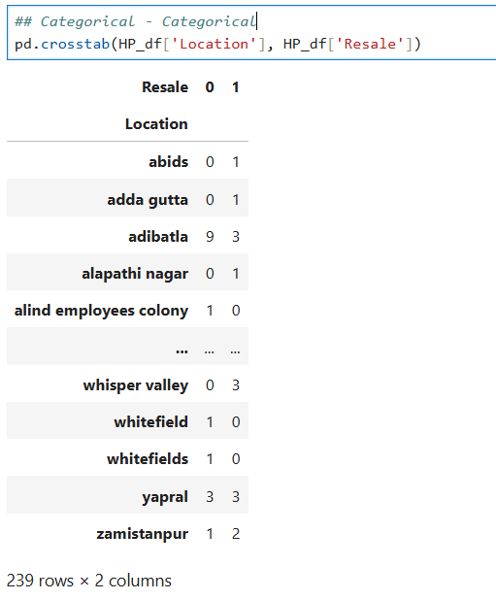
Resale and non-resale property distribution differs across locations, reflecting location-specific market behavior.

Slide 16
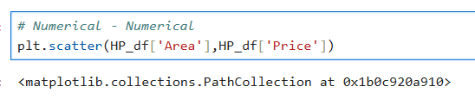
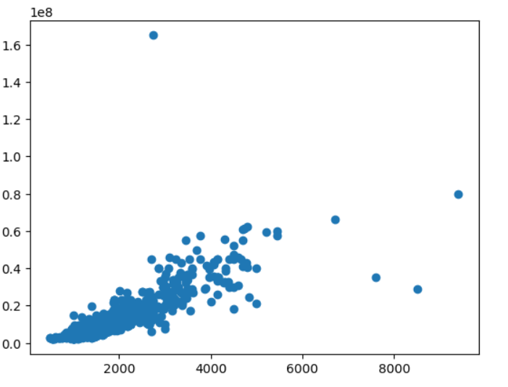
BIVARIATE ANALYSIS ^{(visualization)}
There is a strong positive linear relationship between Area and Price, indicating that property prices increase proportionally as the built-up area increases.
The points are closely clustered along an upward trend, showing a consistent relationship with only a few outliers.

Slide 17

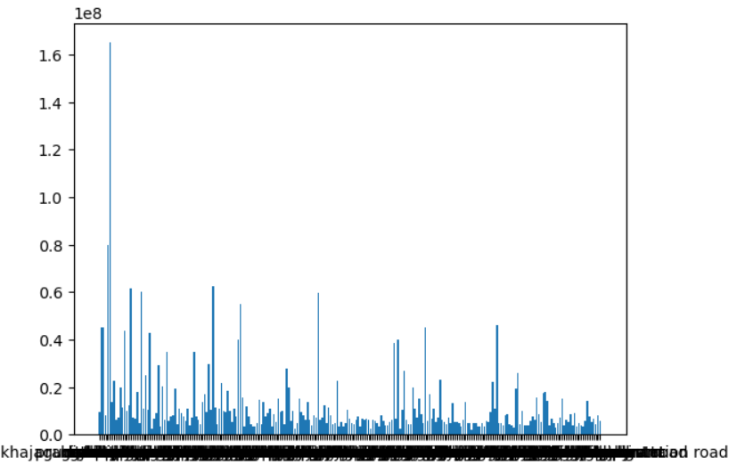
The bar plot shows variation in house prices across different locations, indicating that property prices differ significantly by locality.
Some locations exhibit higher price levels, reflecting their premium nature compared to other areas.
.

Slide 18

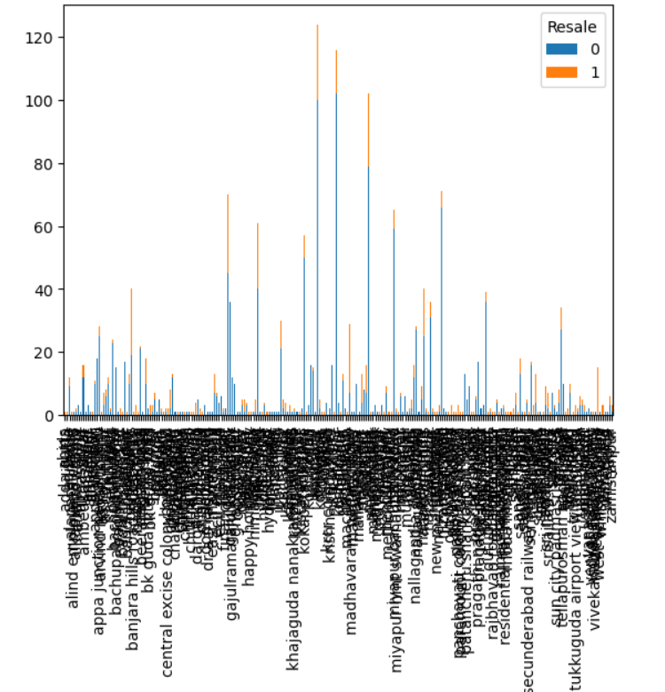
The stacked bar chart illustrates the distribution of resale and non-resale properties across different locations.
It highlights how the proportion of resale properties varies by locality, reflecting differences in housing market dynamics across Hyderabad

Slide 19
OVERALL INSIGHTS
House prices in Hyderabad strongly depend on area and location.
Larger properties tend to have higher prices, showing a clear size-price relationship.
Certain locations consistently show higher price ranges, indicating premium residential areas.
The dataset contains a mix of affordable, mid-range, and luxury properties.
Resale properties are distributed across multiple locations, indicating an active secondary housing market in the city.

Slide 20
CHALLENGES
• The dataset initially contained an invalid value used to represent uncertain data, which required careful identification.
• These invalid values were replaced and subsequently removed to maintain data consistency and reliability.
• Price values showed high variability, making outlier detection an important aspect of the analysis.
• Some locations had fewer records, limiting deeper comparative analysis across all areas.

Slide 21
CONCLUSION
Overall, the Exploratory Data Analysis helped us clearly understand the structure,
quality, and behavior of the housing price dataset.
The data was mostly clean, with no missing values and with some duplicates, which was successfully handled, making the dataset reliable for analysis.
Univariate and bivariate analysis revealed important patterns related to price, area, and location
The insights gained from this analysis can support better real-estate decision-making and further predictive modeling.

Slide 22
THANK YOU

